Slide 1


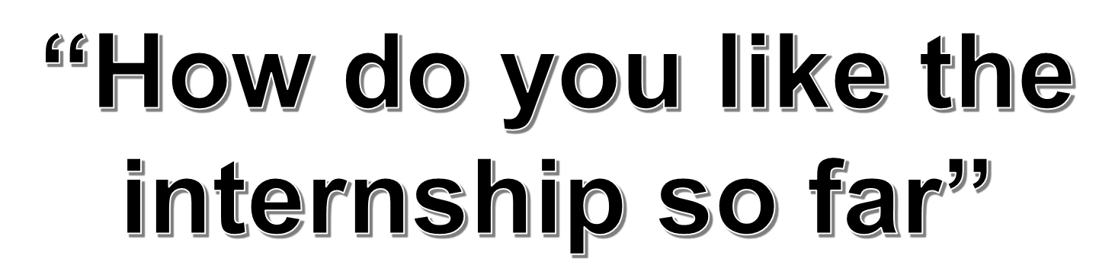
YUXI DENG
COMPUTER SCIENTIST& STATISTICIAN
Top 5 strength
Intellection
Ideation
Learner
Context
Relator

Slide 2

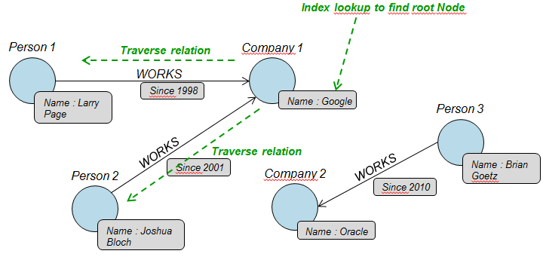





“I learned a ton”
Project 1: Graph Database on relations through text analytics
Input
Output
List of companies
magic.py
Graph Database
Download and clean up files
Extract relationships
Parse the format
Build into graph database

Slide 3
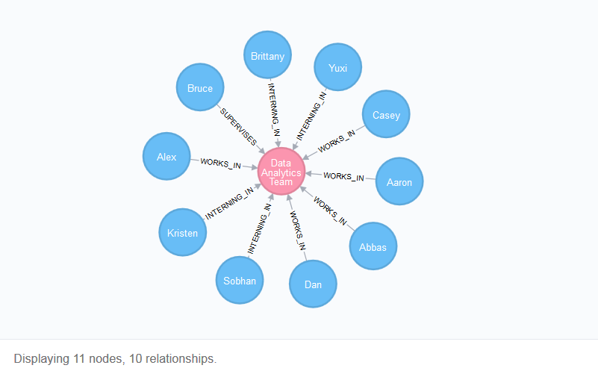
“I learned a ton”
Example of graph database

Slide 4
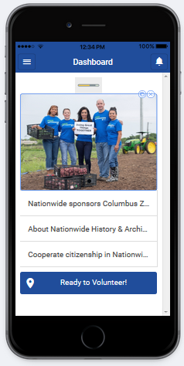
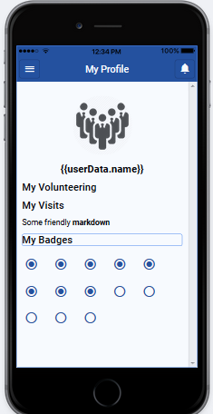
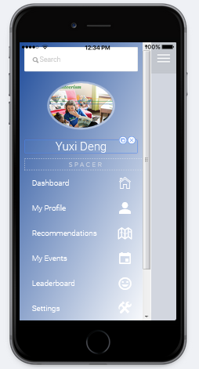



“I learned a ton”
Project 2: Hackathon with KASBYE

Slide 5
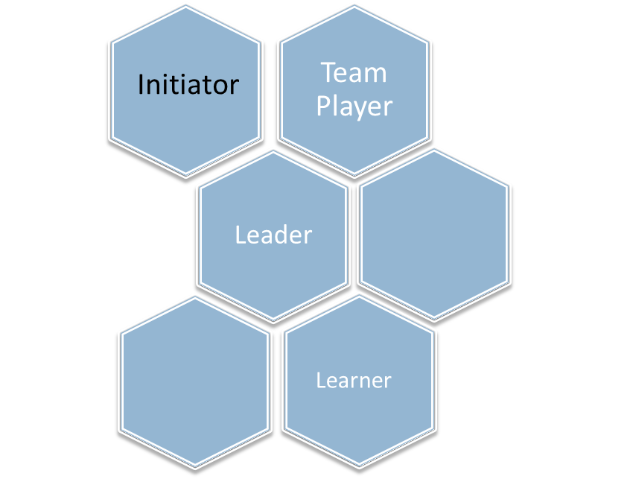
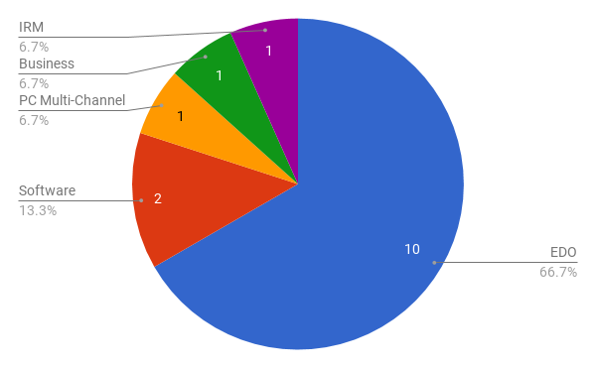
“I learned a ton”
Coffee talks and job shadowing
Soft skills
Communicator
Evolver

Slide 6



“I love the culture here”
Helpful people and great mentors
Volunteering
Rewarding society

Slide 7


